Slide 1

VAST Challenge 2020
Mini-Challenge 1
Supervisor: Prof. Dr.-Ing. Bernhard Preim
Dr.-Ing. Monique Meuschke
M.Sc. Uli Niemann
Presenter: Seyed Behnam Beladi
Atrayee Neog
Xiongjun Wang

Slide 2
Agenda
Introduction
Data and Tasks
Methodology
Graph Comparison
Graph Building
Results and Discussion
Conclusion

Slide 3
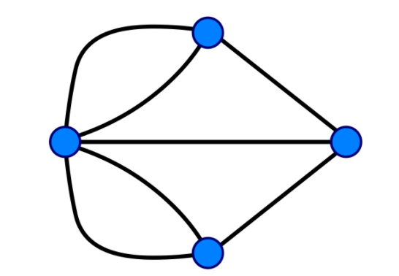
Introduction
The VAST committee conducts a challenge an international challenge focusing on Visualization every year.
This year’s challenge had three Mini challenges to choose from.
This presentation covers the results and methods for Mini Challenge 1 that focused on Graph Analysis.

Slide 4
Mini Challenge 1
The challenge focused mainly on the topics of exploratory graph analysis.
Center for Global Cyber Strategy (CGCS) researchers used the data donated by white hat groups to create anonymized profiles of the groups working around the globe.
One such profile has been identified by CGCS sociopsychologists as most likely to resemble the structure of the group who accidentally caused this internet outage.
The challenge required us to examine CGCS records and identify those groups who most closely resemble the identified profile.

Slide 5
Data Overview
The data provided to us consisted of the following:
A subgraph template representing the structure of the group identified by CGCS, in CSV (comma-separated values) format.
Five candidate subgraphs, in CSV format.
A very large graph in CSV format consisting of 123,892,863 records.
A list of “seeds”, or IDs that can provide starting points for exploring the large graph.
A few other supplement files included further details about the data within these files.
Notes:
GraphData-Nodetypes.csv
Template-Nodetypes.csv
DemographicCategories.csv
NodeTypeDescriptions.csv

Slide 6
Data Understanding
Each file consisted of 6 different channels represented as eTypes.
The channels held records of people, items, places, journals and income-expense categories
Channels formed the basis of the entire functioning of this organization and contributed differently towards the analysis.

Slide 7
Communication Channel (0 & 1)
Call/Email
Person
Person
Call/Email

Slide 8
Procurement Channel (2 & 3)
Buying
Person
Item
Selling

Slide 9
Co-Authorship Channel (4)
Contributed to
Person
(Author)
Publication

Slide 10
Demographic Channel (5)
Income
Person
Category
Expense

Slide 11
Travel Channel (6)
Travelled from
Person
Place
Travelled to

Slide 12
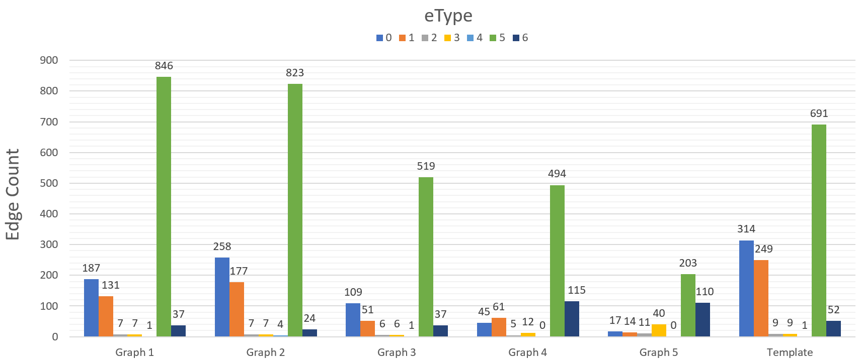
Data Distribution

Slide 13
Methodology
Graph Comparison
Task 1
Task 4
Graph
Building
Task 2
Task 3

Slide 14
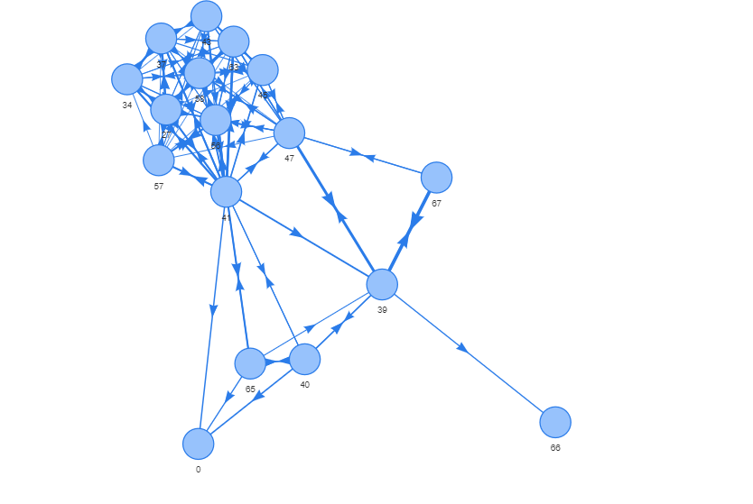
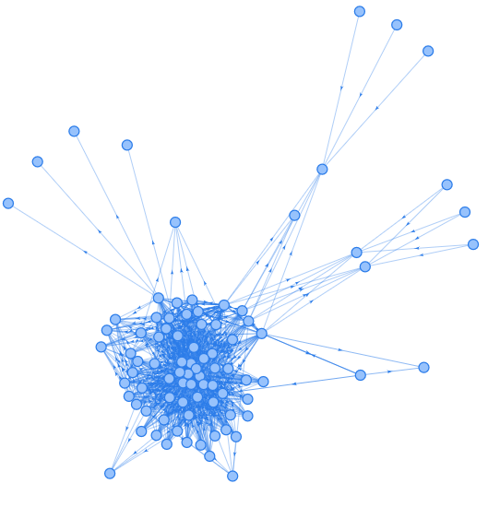
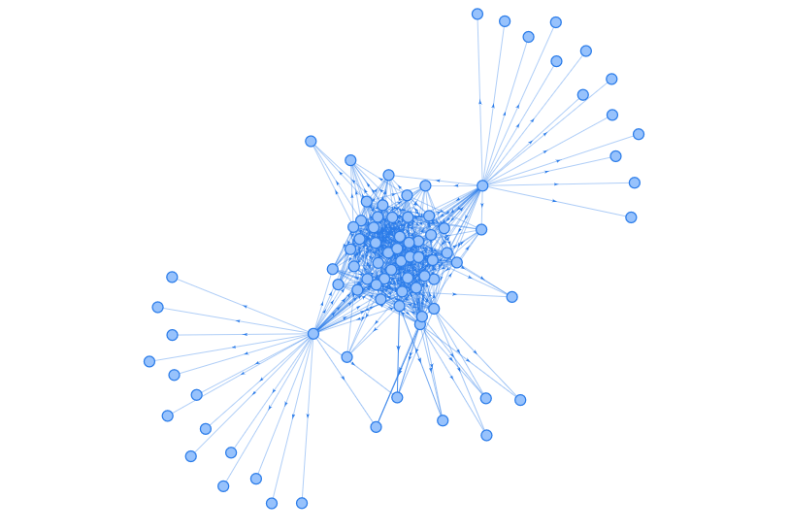
Graph Comparison

Slide 15
Graph Comparison Similarity Measures
Degree
Closeness
Betweenness
Eigen Vector Centrality
K-Nearest Neighbour
Out Degree
Average Neighbour Degree
Page Rank

Slide 16
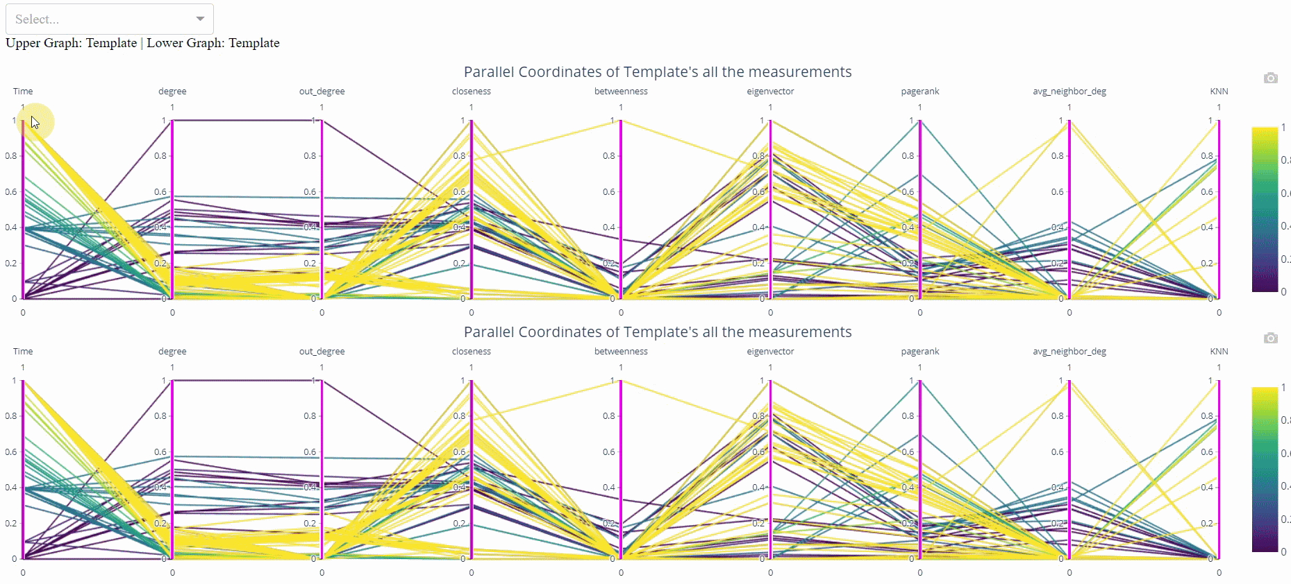
Graph Comparisons Parallel Coordinates

Slide 17
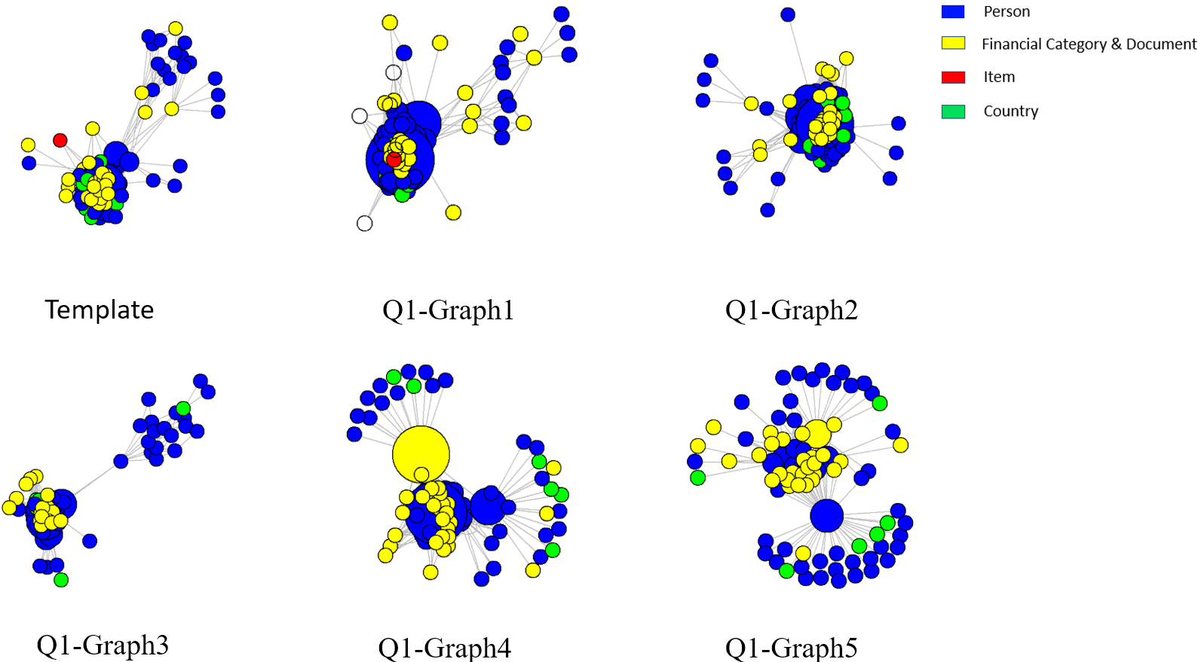
Graph Comparisons Network Graphs

Slide 18
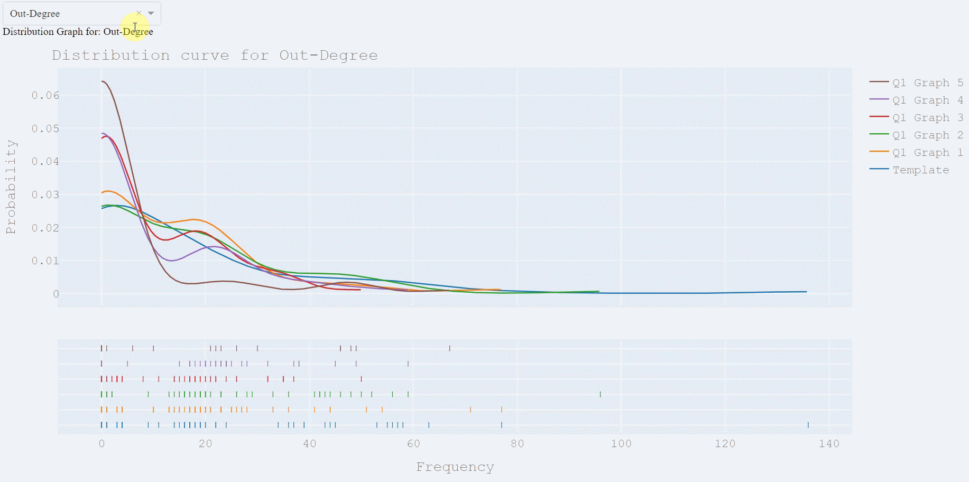
Graph Comparisons
Density Curves

Slide 19
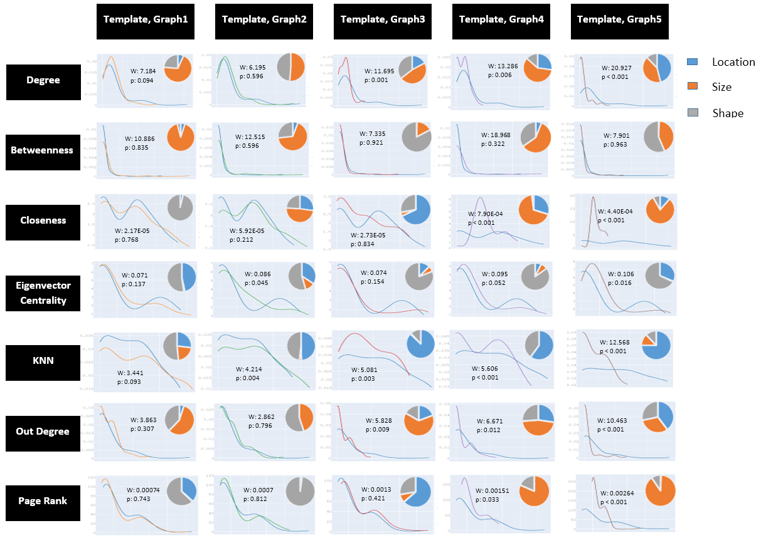
Graph Comparisons Wasserstein Metric

Slide 20
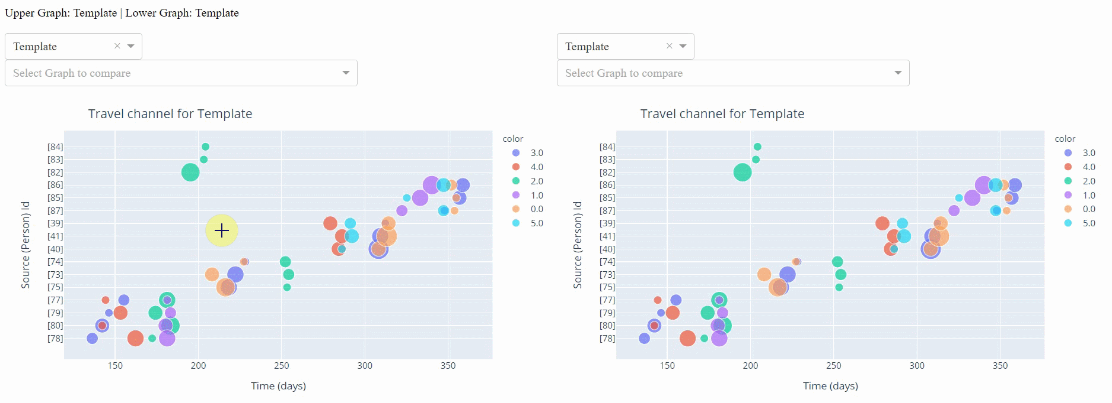
Graph Comparisons Channel Analysis: Travel Channel

Slide 21
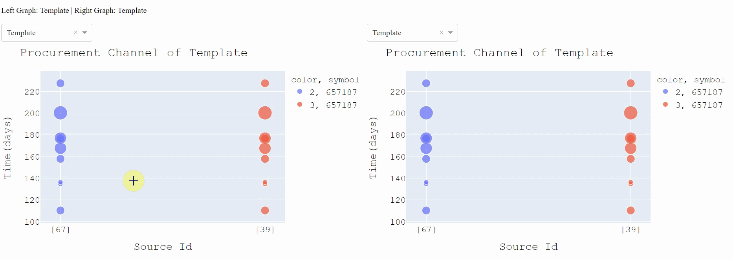
Graph Comparisons Channel Analysis: Procurement Channel

Slide 22
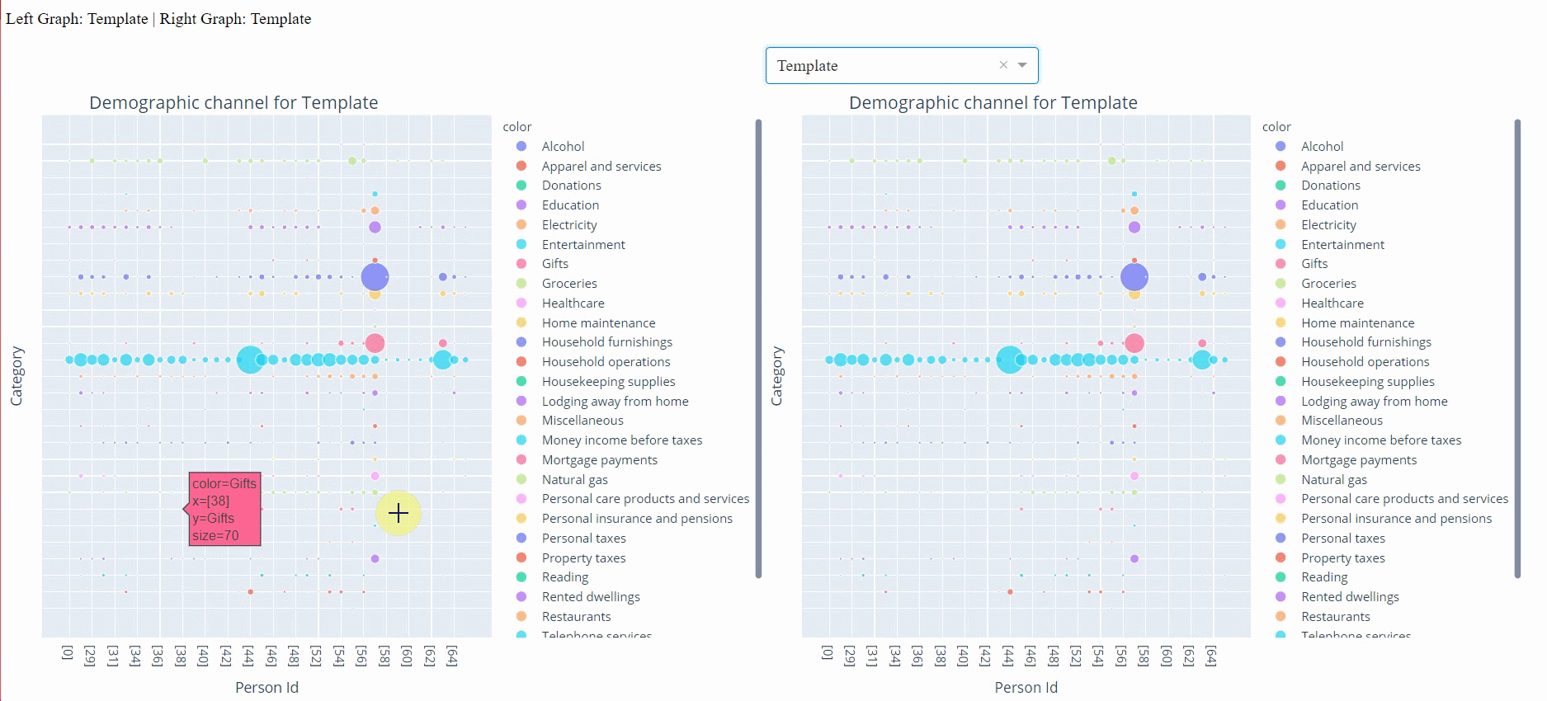
Graph Comparisons Channel Analysis: Demographic Channel

Slide 23
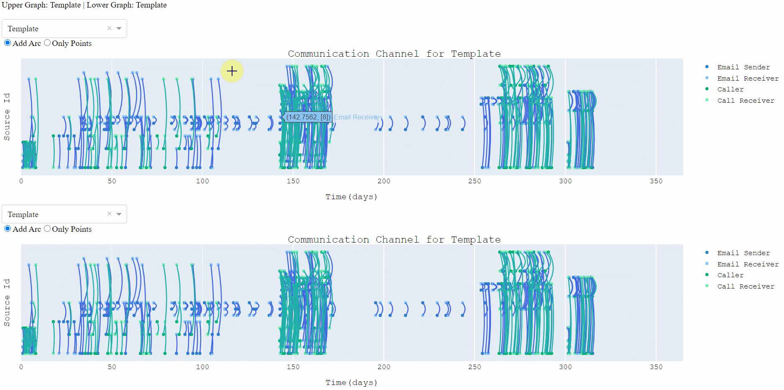
Graph Comparisons Channel Analysis: Communication Channel

Slide 24
Results
For Task 1: subgraph 2 was the closest to the template
For Task 2: seed 1 and seed 3 resulted in a network, but seed 2 wasn’t
For Task 3: two network graphs were created which resembled the template
For Task 4: Out of all subgraphs, subgraph created from seed 1 represented the template the best

Slide 25
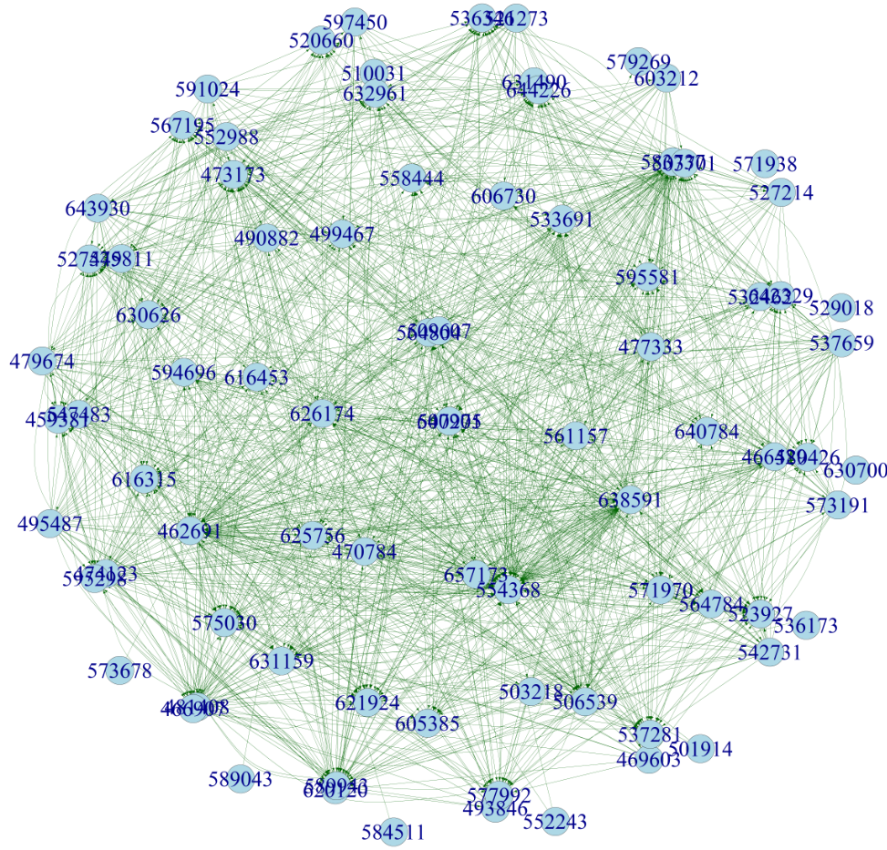
Results
Seed 1 subgraph was found to be the required hacker group

Slide 26
Conclusion
Different visualization and graph handling techniques were implemented.
Various libraries in Python, R and JavaScript were used.
Gained in-depth knowledge on how to deal with complex, interconnected data structures.
The correct conclusions were drawn for almost all the tasks for which we received great reviews.
For Task 1, subgraph 1 and subgraph 2 were the two most closest to the template, but subgraph 1 was the actual winner.
The Wasserstein metric and the similarity measures were better suited for probabilistic graph comparisons whereas our graphs were deterministic.
Hence, a more detailed interaction with the graphs through visualization could have led us towards the correct conclusion effectively.

Slide 27
Thank You

